Slide 1



Name of Project:
Financial Analysis Dashboard using Power BI

Slide 2

Learning Objectives:
- Understand financial trends through data visualization.
- Identify key revenue drivers and sales performance.
- Analyze product and region-wise sales contributions.
- Develop a dashboard for strategic business decisions.
GOAL
Source :
www.freepik.com/

Slide 3
Tools and Technology used
- **Microsoft Power BI** for data visualization.
- **Excel** as the primary data source.
- **DAX (Data Analysis Expressions)** for calculations and analysis.
- **Power Query** for data transformation.

Slide 4
Methodology
**Step 1: Data Collection & Cleaning**
- Import financial data from Excel into Power BI.
- Handle missing values and clean data for consistency.
**Step 2: Data Transformation & Modeling**
- Use Power Query to shape data appropriately.
- Establish relationships between tables for accurate reporting.
**Step 3: Visualization & Dashboard Development**
- Create key visuals (bar charts, line charts, maps, KPIs, etc.).
- Design an interactive dashboard with filters and drill-throughs.
**Step 4: Insights & Business Recommendations**
- Analyze sales trends, profit margins, and revenue streams.
- Provide recommendations for business improvements.

Slide 5
Problem Statement:
Businesses often struggle with analyzing large financial datasets and extracting meaningful insights. Without proper visualization, decision-making becomes challenging.

Slide 6
Solution:
**A comprehensive Power BI dashboard that provides:**
- **Sales & Profit Trends:** Understanding revenue growth over time.
- **Region-wise Analysis:** Identifying high-performing locations.
- **Product-wise Revenue Distribution:** Evaluating best-selling products.
- **Impact of Discounts:** Understanding how pricing strategies affect sales.
- **Key Performance Indicators (KPIs):** Monitoring financial health.

Slide 7
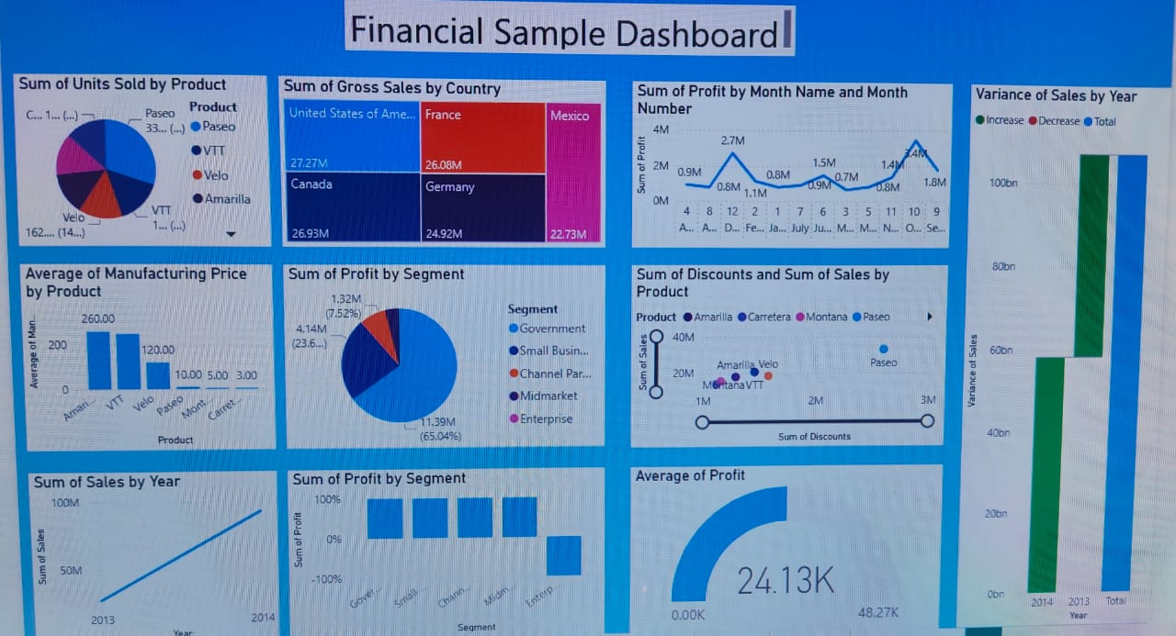
Screenshot of output:

Slide 8
Conclusion:
The **Financial Analysis Power BI Dashboard** provides actionable insights into sales trends, revenue distribution, and profitability. By leveraging data visualization, businesses can enhance decision-making, optimize pricing strategies, and identify growth opportunities.

